Slide 1
Predicting Mobile Application Success Linear Regression Report

Slide 2
Team Members
# | Name | ID
1 | Noor al_Fattha Tarek Mohamed | 20192107
2 | George Ayad | 20190577
3 | Omar Abdelaziz Hussein | 20192801
Under Supervision of TA/ Ayman Adel Iskandar
Group A1.1 Monday

Slide 3
Predicting Mobile Application Success - Regression
Given that we are predicting the average rating of an application then our goal is “Rating”
Since the dataset contains Textual and Numerical values, then we need to eliminate the Textual values and decide which Numerical values to use.
App Name, Category, Size, Content R, Last Updated, Minimum Version and Latest Version are Eliminated
Rating is Selected as Goal (Dependent Variable) and (Reviews, Installs and Price) are selected as feature (Independent Variables).

Slide 4
Predicting Mobile Application Success - Regression
Since Installs and Price contain Textual Characters then we will need to clean this data to be Numerical
For example, in Installs (5,000,000+) we will replace commas and ‘+’ with “” so we get the value 5000000 (Numerical Value)
Same with Price (300$) we will replace ‘$’ with “” so we get the value 300 (Numerical Value)
This will help fitting data in the Regression Model

Slide 5
Predicting Mobile Application Success - Regression
After cleaning data, now we can use the dataset for the Regression model
Using different combinations will lead us to use (Multiple Linear Regression and Simple Linear Regression)
In all cases, we will keep 70% as Training Data and 30% as Testing Data with Random State set to 0

Slide 6
Predicting Mobile Application Success - Regression
Since we have 3 Independent Variables (Features) then we have the following combinations to try in order to get the best accuracy:
# | Independent Variables (Features) | Regression Type
1 | Installs, Reviews and Price | Multiple Linear Regression
2 | Installs and Reviews | Multiple Linear Regression
3 | Installs and Price | Multiple Linear Regression
4 | Reviews and Price | Multiple Linear Regression
5 | Installs | Simple Linear Regression
6 | Reviews | Simple Linear Regression
7 | Price | Simple Linear Regression

Slide 7
Predicting Mobile Application Success - Regression
After testing the 7 scenarios mentioned in the table, we get the following Mean Square Error Values:
# | Independent Variables (Features) | Mean Square Error
1 | Installs, Reviews and Price | 0.25210788026671194
2 | Installs and Reviews | 0.25213936877777726
3 | Installs and Price | 0.25229917930636686
4 | Reviews and Price | 0.25210550932414294
5 | Installs | 0.2523297799214725
6 | Reviews | 0.2521369831357569
7 | Price | 0.2523448120475784

Slide 8
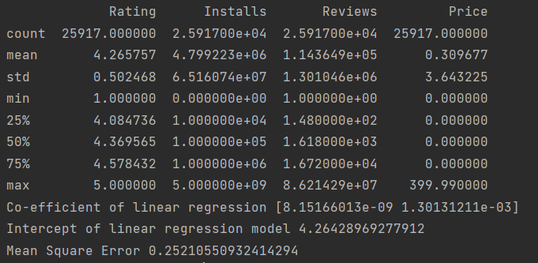
Predicting Mobile Application Success - Regression
By Looking at the results, we find that the best combination (With the least Mean Square Error) is Reviews and Price
This means that selecting Reviews and Price together as Independent Variables/Features, gives a better accurate result for the prediction.

Slide 9
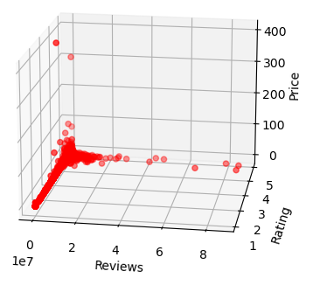
Plotting Data
Reviews and Price (as features) and Rating (as Target)

Slide 10
Python Code
Imports:
import pandas as pd
import numpy as np
import matplotlib.pyplot as plt
from sklearn.model_selection import train_test_split
from sklearn import linear_model
from sklearn import metrics
from mpl_toolkits.mplot3d import Axes3D

Slide 11
Python Code
Reading, Cleaning and Printing Data:
data = pd.read_csv('Mobile_App_Success_Regression.csv’)
data['Installs'] = data['Installs'].str.replace(',', '').str.replace('+', '').astype(np.int64)
data['Price'] = data['Price'].str.replace('$', '').astype(float)
print(data[['Rating', 'Installs', 'Reviews', 'Price']].describe())

Slide 12
Python Code
Plotting Data:
fig = plt.figure()
ax = fig.add_subplot(111, projection='3d')
x = data['Reviews']
y = data['Rating']
z = data['Price']
ax.scatter(x,y,z, c='red', marker='o')
ax.set_xlabel('Reviews');
ax.set_ylabel('Rating');
ax.set_zlabel('Price');
plt.show()

Slide 13
Python Code
Selecting Feature Columns and Target then Splitting Data into Training and Testing:
feature_cols = ['Reviews', 'Price'] #Here we selected Reviews and Price Only
X = data[feature_cols]
Y = data['Rating’]
X_train,X_test,Y_train,Y_test=train_test_split(X,Y,test_size=0.30,random_state=0)

Slide 14
Python Code
Creating Linear Regression Model and Fitting Training Data to the model then predict the Testing Data:
cls = linear_model.LinearRegression()
cls.fit(X_train,Y_train)
prediction= cls.predict(X_test)

Slide 15
Python Code
Printing the Co-efficient, Intercept and Mean Square Error:
print('Co-efficient of linear regression',cls.coef_)
print('Intercept of linear regression model',cls.intercept_)
print('Mean Square Error', metrics.mean_squared_error(Y_test, prediction))

Slide 16
Conclusion
Dataset must be well prepared and data-cleaned before using in the model.
Deciding Features requires logic relations between the independent and dependent variables.
Selecting the best accuracy requires trying all the possible combinations of the independent variables, reaching to the least Mean Square Error value.
Changing the size of training and testing sets, affects the accuracy of the model.

Slide 17
Thank you

